Slide 1

MEDICAL IMAGING & BIG DATA PROJECT
Carnati Emanuele 781231 De Cicco Alessandro 834225 Mammana Lorenzo 807391

Slide 2
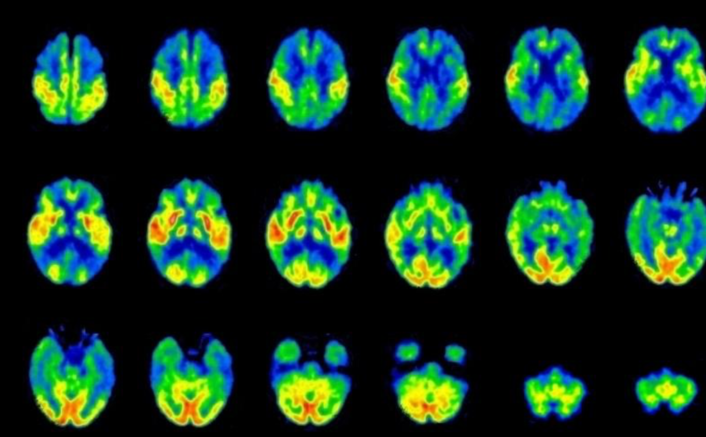
Table of contents
Introduction
Goal of the Project & Dataset
Feature Extraction
Feature Selection
Classification Models - SVM - Decision Tree - K-Means Clustering
Conclusions

Slide 3
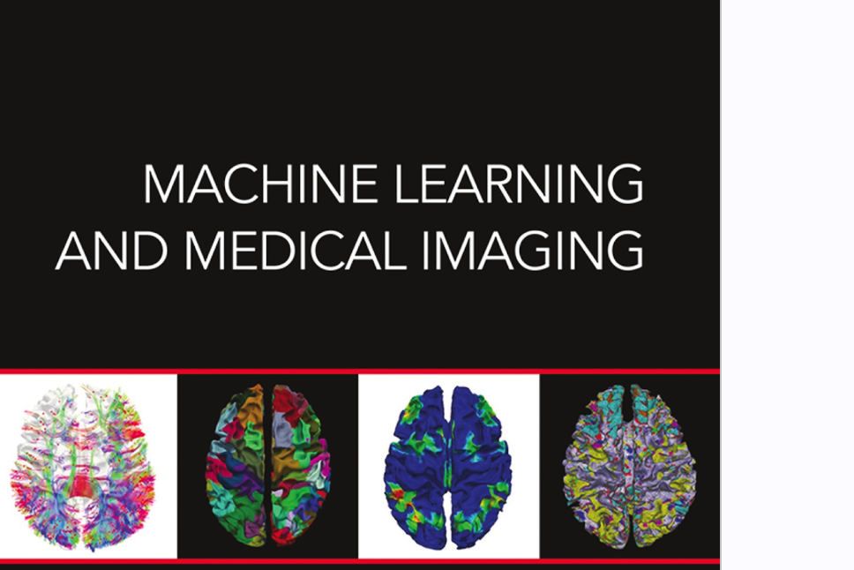
1.
Introduction

Slide 4
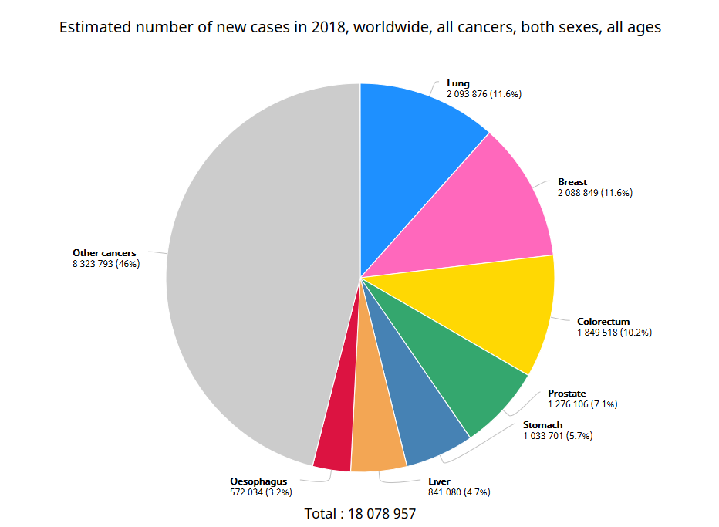
Why medical imaging?
Cancer is the second leading cause of death globally.
While medical knowledge forms the basis of health practitioners decisions, medical imaging is a vital part of confirming any diagnosis.
It can also inform the doctor of internal problems that a basic external examination would fail to detect.
[1]
Fig. 1 Estimated number of new cases in 2018, worldwide, both sexes, all ages. GLOBOCAN 2018

Slide 5
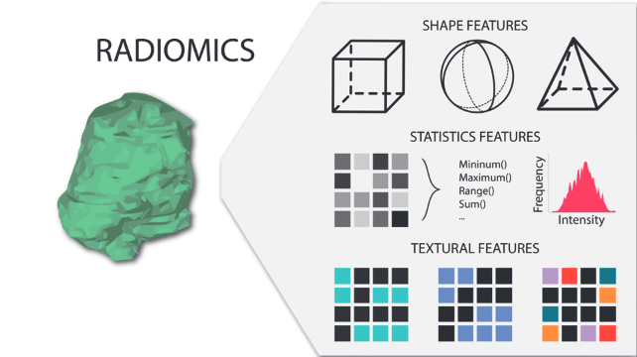
The importance of radiomics
Radiomics is a field of medical study that aims to extract large amount of quantitative features from medical images.
These features have the potential to uncover disease characteristics hardly noticeable by the naked eye.
Fig. 2 Radiomics features [1]

Slide 6
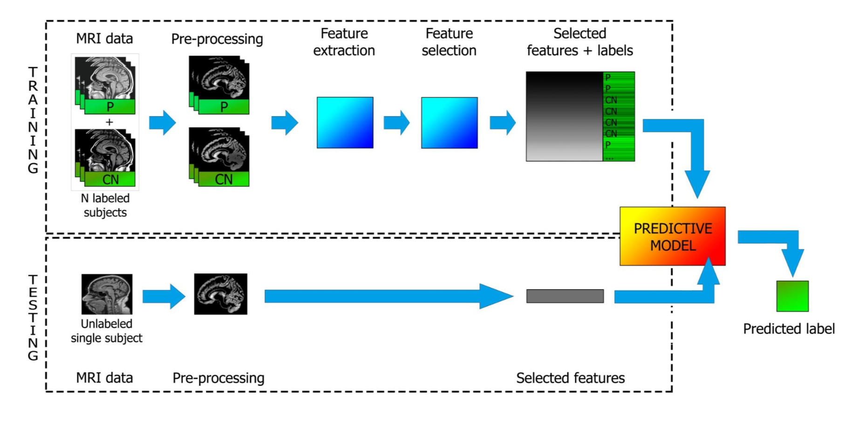
Machine learning applied to
medical imaging
A large number of features allow computer science experts to build machine learning models.
Machine learning in radiology is expected to have a substantial clinical impact with imaging examinations being routinely obtained in clinical practice, providing an opportunity to improve decision support in medical image interpretation.
Fig. 3 Typical machine learning workflow. Christian Salvatore, Medical Imaging & Big Data course 2019, unimib

Slide 7
2.
Goal of the project & dataset

Slide 8
MATLAB
KNIME
Goal of the project
The goal of the project is the creation of a predictive model capable to classify heterogeneous and homogeneous tumour lesions.
We have been working with:
Matlab
Knime
- R
PREDICTIVE MODEL
R
RADIOMICS

Slide 9
Dataset
44 images of metabolic tumour volumes in NIfTI format.
Based on synthetic lesion constructed from real patient data.
Segmented using two different thresholds, one adaptive and one fixed [2].
Mostly homogeneous lesions (59%).
Some lesions very similar.

Slide 10
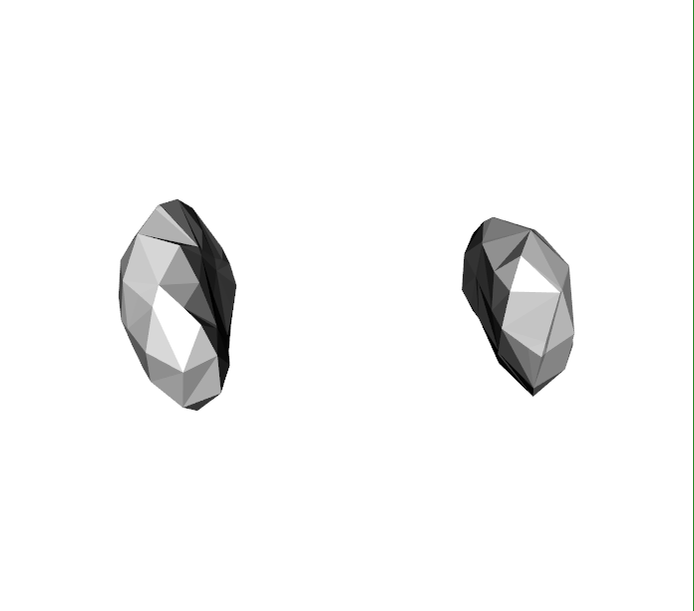
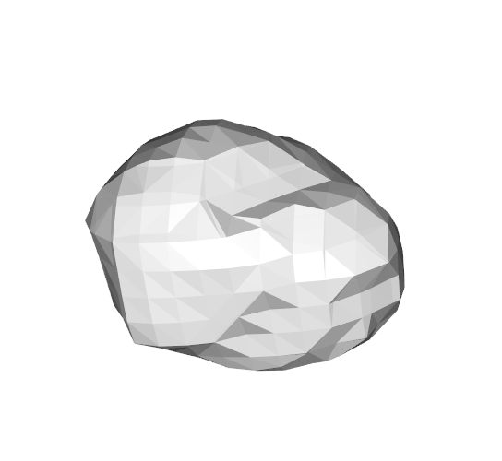
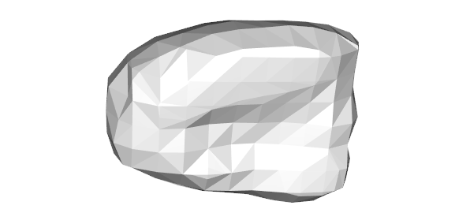
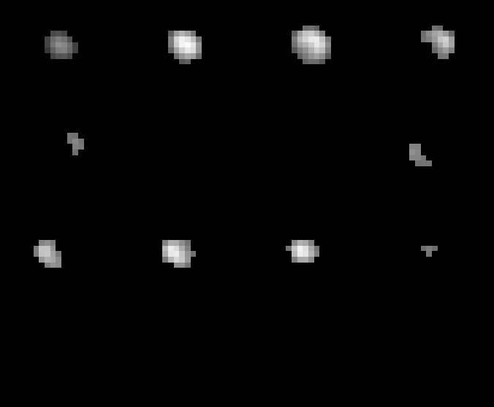
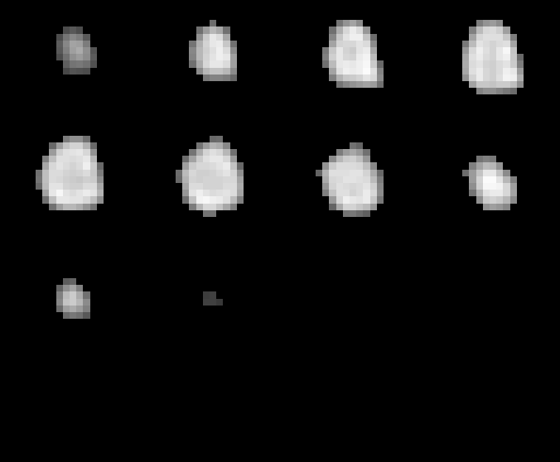
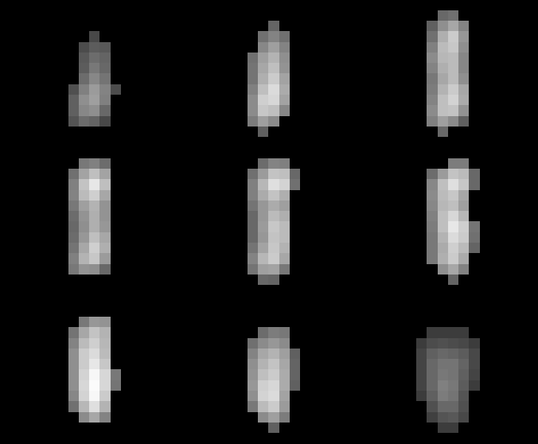
Dataset samples

Slide 11
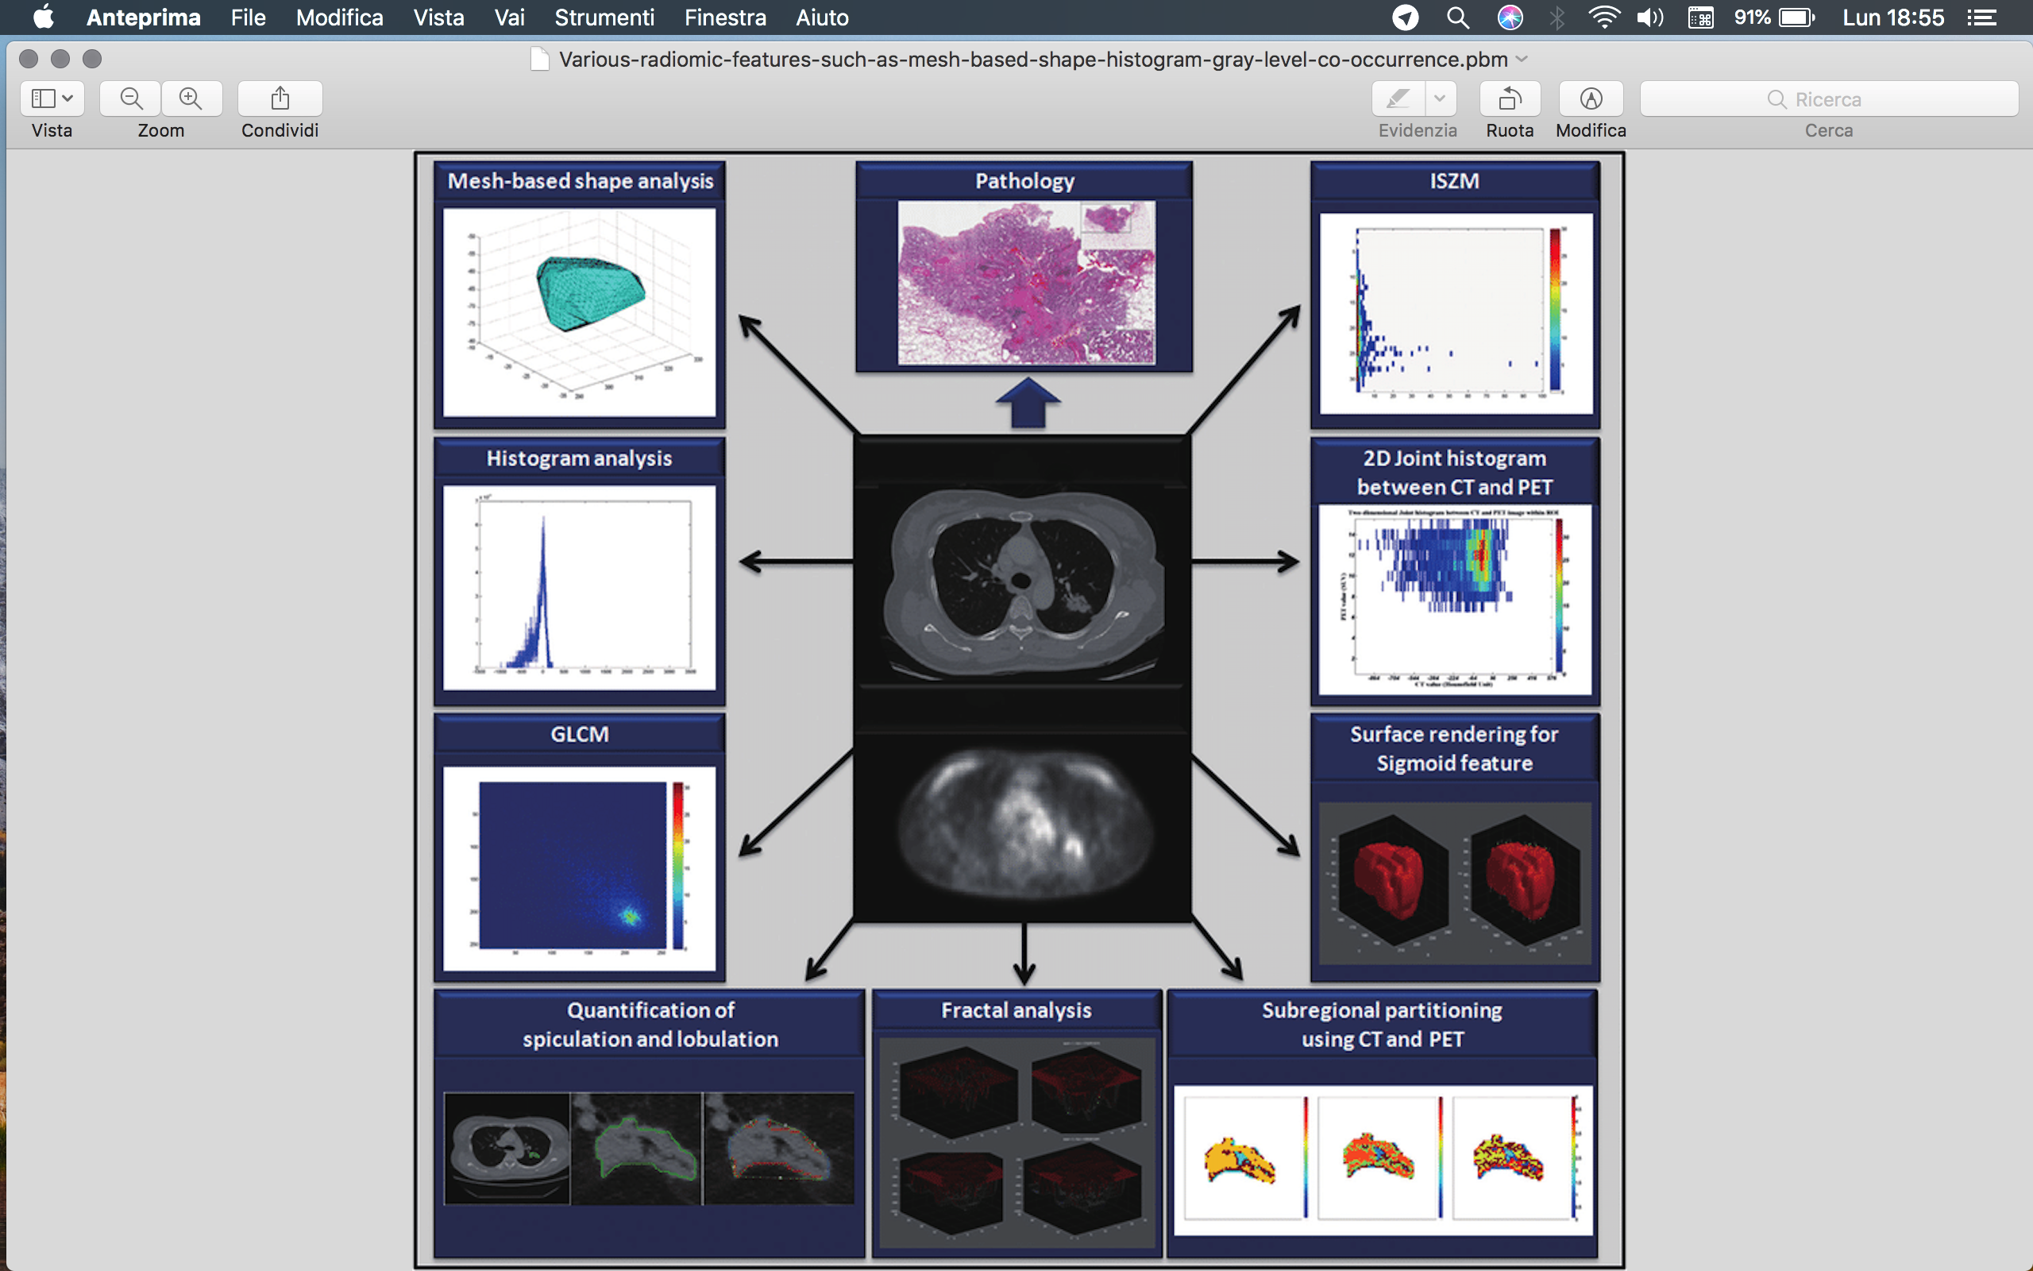
3.
Feature extraction

Slide 12
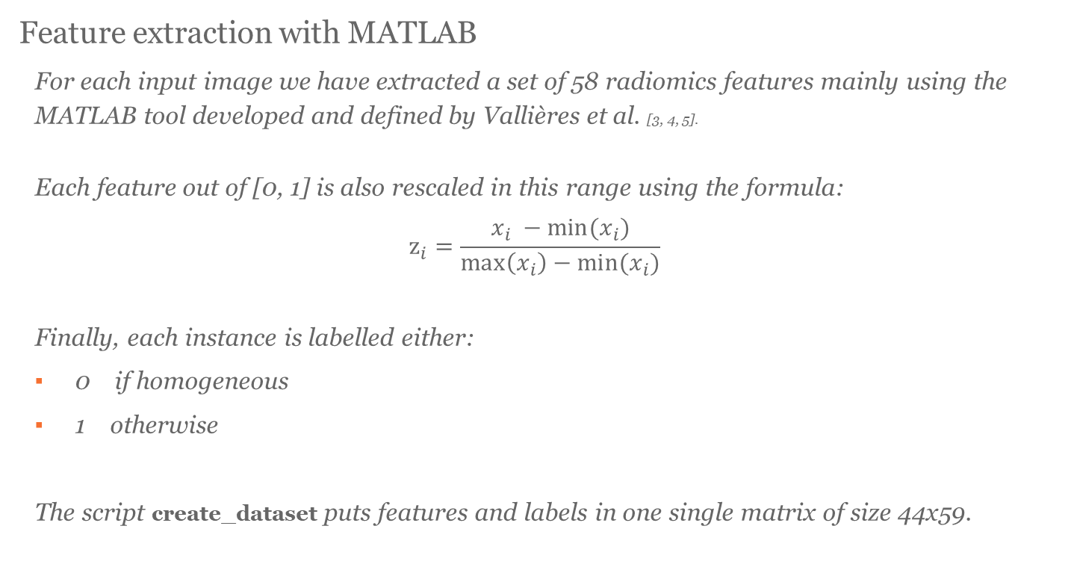
Feature extraction with MATLAB
For each input image we have extracted a set of 58 radiomics features mainly using the MATLAB tool developed and defined by Vallières et al. [3, 4, 5].
Each feature out of [0, 1] is also rescaled in this range using the formula:
$$z_{i}=\frac{x_{i} −min⁡(x_{i})}{\max\left(x_{i}\right)−min⁡(x_{i})}$$
Finally, each instance is labelled either:
0 if homogeneous
1 otherwise
The script create_dataset puts features and labels in one single matrix of size 44x59.

Slide 13
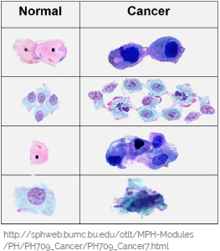
Features extracted
Morphological features: 5/59 Concern the features relating to lesions shape like surface, sphericity and metabolic target volume (MTV).
Usually, the more irregular the shape, the more aggressive is the tumour.
Histogram-based features: 13/59 These features include various descriptive statistics indices relating voxel gray level of the lesions such as kurtosis, entropy, skewness, uniformity etc.

Slide 14
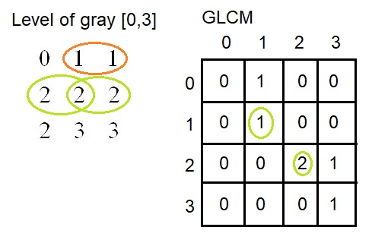
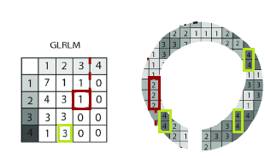
Features extracted GLCM (Gray Level Co-Occurence Matrix): 9/59 This matrix quantifies the number of times that the combinations of level dimensions occur in two pixels. They are: energy, contrast, dissimalrity, homogeneity, correlation, autocorrelation, variance, sum average and entropy. GLRLM (Gray Level Run Length Matrix): 13/59 Quantifies the length of number of consecutive pixels for each level of gray along one dimension. Both GLCM and GLRLM are rotation dependent.

Slide 15
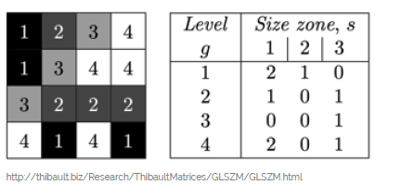
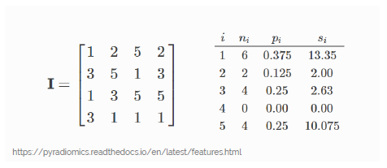
Features extracted
GLSZM(Gray-Level Size Zone Matrix): 13/59 Represents the number of connected voxels that share the same gray level intensity. These features are rotation indepedent.
NGTDM(Neighbouring Gray Tone Difference Matrix): 5/59 Quantifies the difference between a gray value and the average gray value of its neighbours.

Slide 16
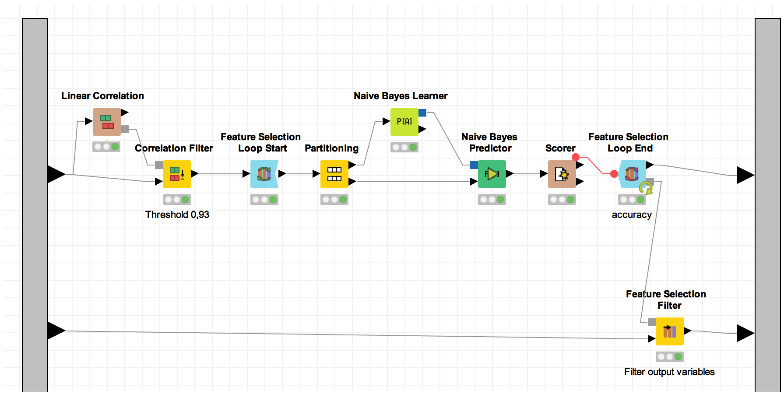
4.
Feature Selection

Slide 17
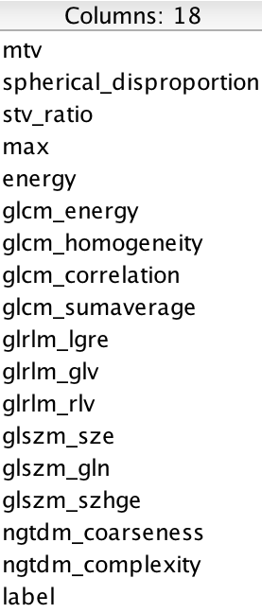
Feature selection
The feature selection method is based on a naive bayesian forward selection implemented in KNIME.
A correlation filter is applyed before performing this method. It reduces our feature set by removing highly correlated features (PCC > 0.9).
A smaller feature set reduces model complexity and tends to prevent overfitting.
After the iterations, 17 columns are chosen, beyond the label column.

Slide 18
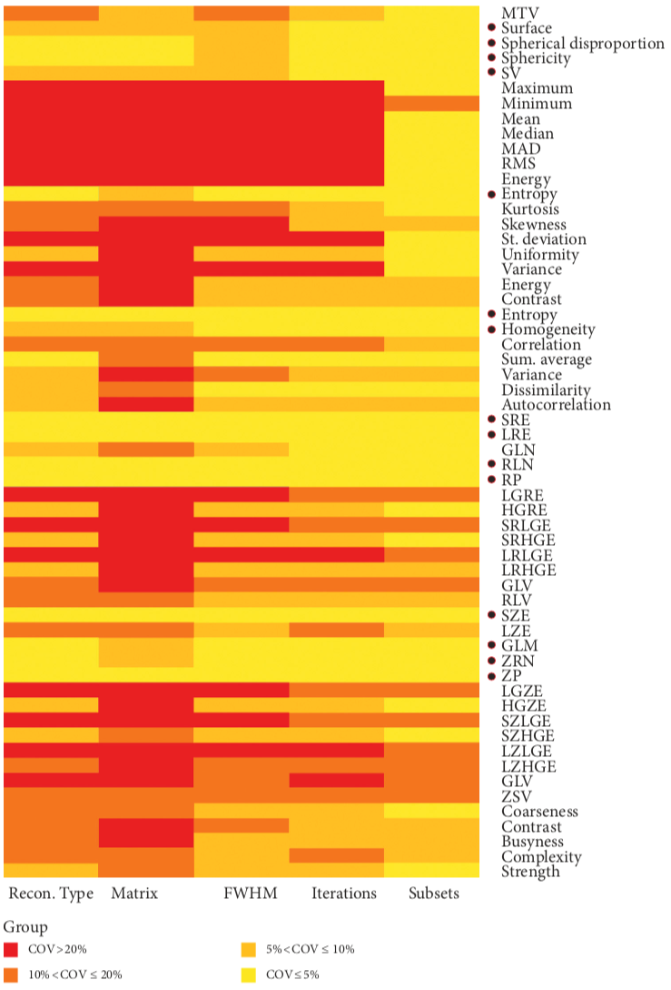
We have then evaluated the stability of the selected features with literature [2] in order to analyze how much our model could work with unseen data from different experimental conditions.
W.r.t the chosen reconstruction method of the lesions our model contains 5 of the 15 features indicated to be stable (COV ≤ 10 %):
Spherical disproportion
SV
GLCM_Homogeneity
GLSZM_SZE
GLSZM_GLM

Slide 19
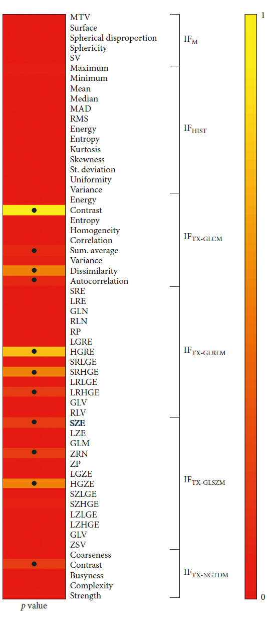
With respect to the chosen segmentation method of the lesions our model contains just 2 of the 11 features indicated to be stable (p value ≥ 0.05):
GLCM_Sumaverage
GLSZM_SZE

Slide 20
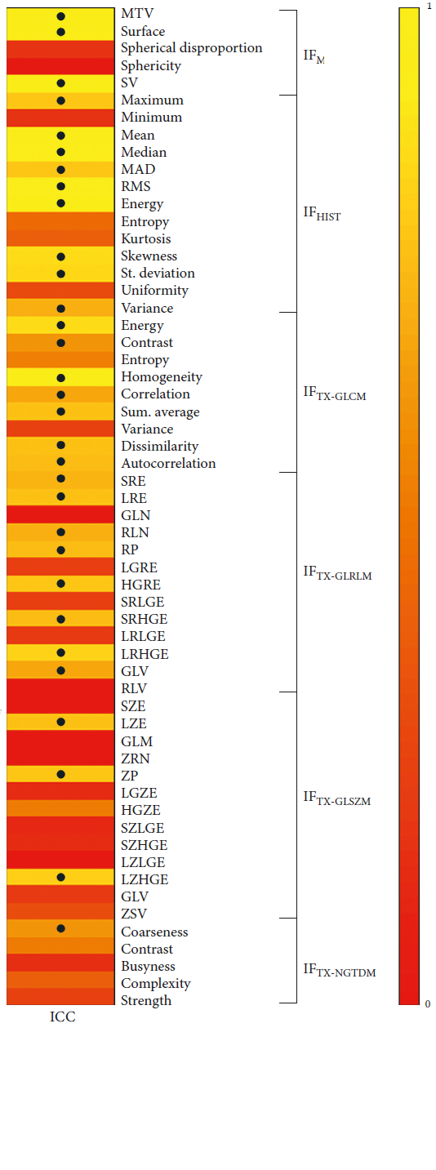
Finally 10 out of 31 reliable features extracted using a test-retest experiment (ICC ≥ 0.6) have been selected.
The features selected are mainly good because they can be considered reliable over time, but the final model could have problem when new data come segmented or reconstructed in a different way of the original training data.

Slide 21
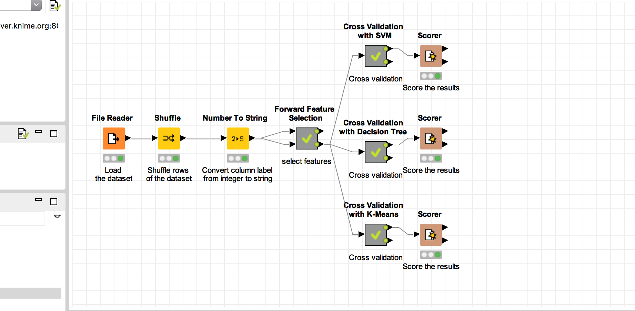
5.
Classification models
SVM
Decision Tree
k-Means Clustering

Slide 22
Model
score
4-fold cross validation
All the 3 classification models implemented are based on stratified 4-fold cross validation.
The dataset is splitted into 4 subsets and iteratively 3 subsets are selected as training set while the remaining subset is used for the evaluation of the trained model.
The choice of 4 folds is based on the size of the dataset.
With more folds, such a small dataset would have lead to insignificant test sets and thus uncorrected evaluations.
Cross validation training
Feature selection
Advantages of cross validation:
Each sample of the original dataset is used once for validation.
All samples being used for both training and testing phases.

Slide 23
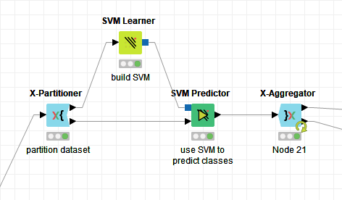
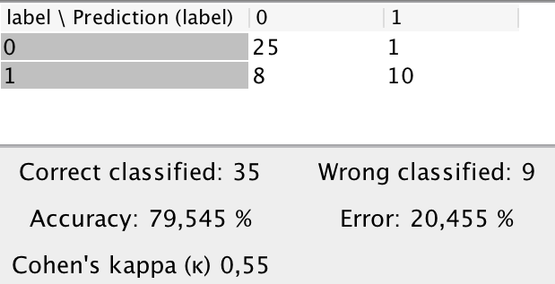
SVM – feature selection
RBF-kernel with γ = 0.5 and C = 1

Slide 24
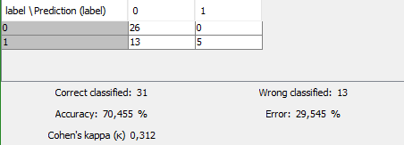
SVM – all features
RBF-kernel with γ = 0.5 and C = 1
DA CAMBIARE
DA CAMBIARE

Slide 25
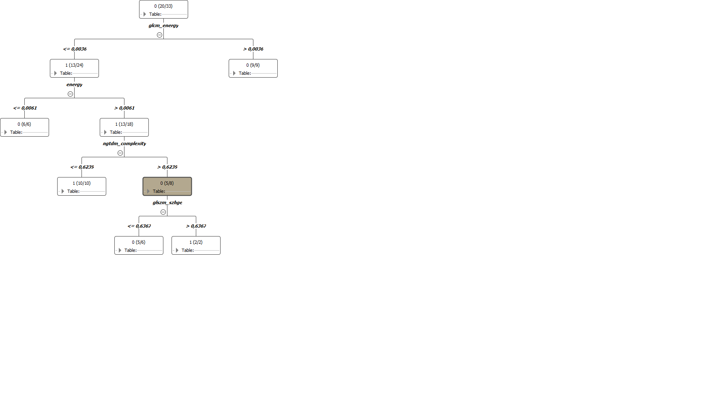
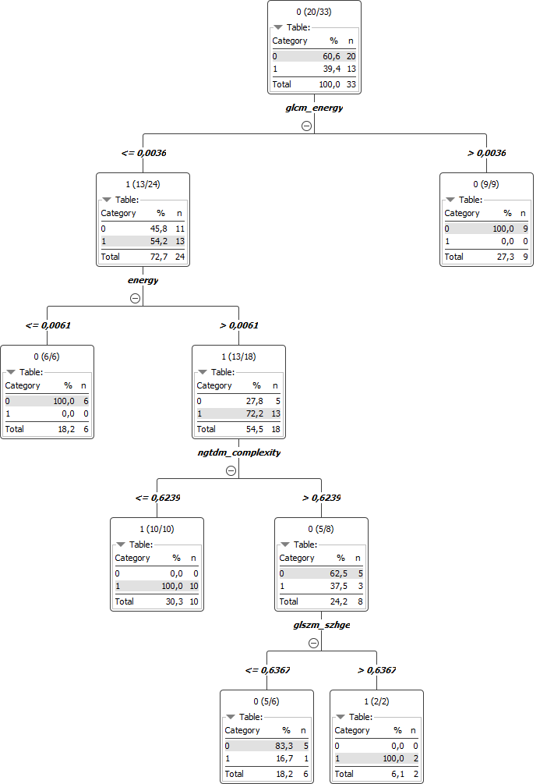
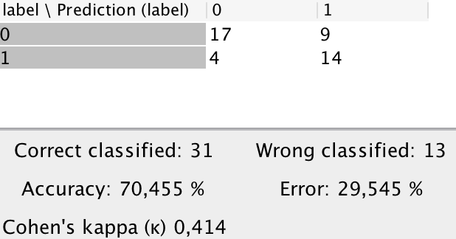
Decision Tree – feature selection
DA CAMBIARE
DA CAMBIARE

Slide 26
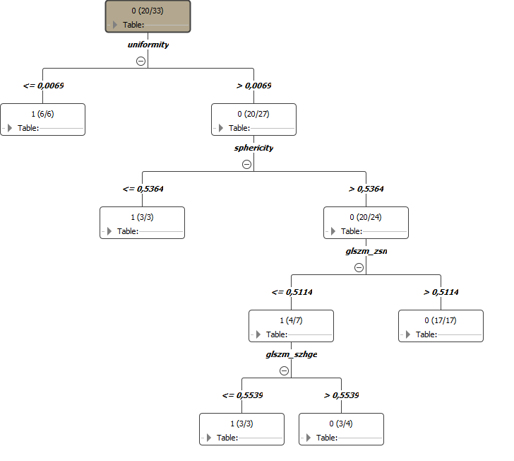
Decision Tree – all features
DA CAMBIARE
DA CAMBIARE

Slide 27
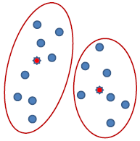
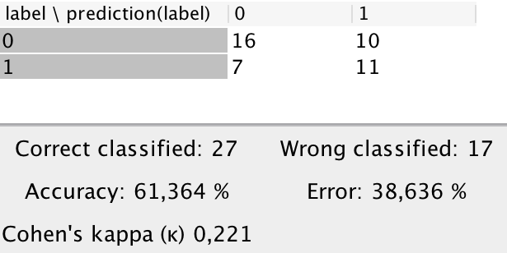
K-means clustering – feature selection
2 cluster, 99 iterations
DA CAMBIARE
DA CAMBIARE

Slide 28
K-means clustering – all features
2 cluster, 99 iterations
DA CAMBIARE
DA CAMBIARE

Slide 29
Results analysis
The best model in term of accuracy is the SVM which achieves an accuracy of 79.5 %.
Despite the high accuracy, the model is not great because fails to classify positive examples (label 1), this is clearly visible since the sensitivity is very low (0.556).
The decision tree performs a little better on the positive class but fails a lot more on the negative class.
Finally the k-means clustering shows very low performances on both positive and negative classes.
All the models except k-means have beneficiated of feature selection with an accuracy increase of circa 10 %.

Slide 30
CONCLUSIONS
89,526,124$
That’s a lot of money
89,526,124
185,244 users
And a lot of users
Description
100%
Total success!
Bring the attention of your audience over a key concept using icons or illustrations

Slide 31
Bibliography
[1] Coroller, T. P. (2017). Combining data science and medical imaging: Advancing cancer precision medicine with radiomics. Maastricht: Datawyse / Universitaire Pers Maastricht
[2] Francesca Gallivanone, Matteo Interlenghi, Daniela D’Ambrosio, Giuseppe Trifirò, and Isabella Castiglioni, “Parameters Influencing PET Imaging Features: A Phantom Study with Irregular and Heterogeneous Synthetic Lesions,” Contrast Media & Molecular Imaging, vol. 2018
[3] Vallières, M. et al. (2015). A radiomics model from joint FDG-PET and MRI texture features for the prediction of lung metastases in soft-tissue sarcomas of the extremities. Physics in Medicine and Biology, 60(14), 5471-5496. doi:10.1088/0031-9155/60/14/5471
[4] Zhou, H., Vallières, M., Bai, H.X. et al. (2017). MRI features predict survival and molecular markers in diffuse lower-grade gliomas. Neuro-Oncology, 19(6), 862-870. doi:10.1093/neuonc/now256
[5] Vallière, M. et al. (2017). Radiomics strategies for risk assessment of tumour failure in head-and-neck cancer. Scientific Reports, 7:10117. doi:10.1038/s41598-017-10371-5

Slide 32
xxx

Slide 33
xxx

Slide 34
xxx

Slide 35
xxx

Slide 36
xxx

Slide 37
xxx

Slide 38
xxx

Slide 39
This template is for a SlideDoc
A slidedoc is a visual document, developed in presentation software, that is intended to be read and referenced instead of projected.
Slidedocs help you spread your smart thinking by combining visual communications with short chunks of written copy. Their scannable nature makes them great pre-read, reference, and leave-behind materials. Their modularity makes it easy for people to incorporate your ideas into their own communications. And these features together make slidedocs the perfect companion to both written documents and presentations.
Text from duarte.com/slidedocs

Slide 40
Hello!
Nice to meet you
Use the first slides to present yourself or your company. Remember that you may not be presenting this document directly.
Contact us at:
www.ourwebsite.com
hello@mail.me
@companyname

Slide 41
Quotations are commonly printed as a means of inspiration and to invoke philosophical thoughts from the reader.

Slide 42
This is a slide title
SlideDocs are for distribution; they’re not optimized for presenting. Slides have too much text and font size is too small for an audience to read it projected in a screen.
These documents are useful for:
Distribute before a meeting when the topic is highly complex or technical
To fully explain your idea before booking a meeting with someone
As a reference and follow-up material
Distribute
Explain
Follow-up

Slide 43
You can also split your content
Try to communicate ideas visually using graphs, icons, illustrations, photos… any resource that helps you convey your message at a glance.
White
Is the color of milk and fresh snow, the color produced by the combination of all the colors of the visible spectrum.
Black
Is the color of coal, ebony, and of outer space. It is the darkest color, the result of the absence of or complete absorption of light.

Slide 44
In two or three columns
Yellow
Is the color of gold, butter and ripe lemons. In the spectrum of visible light, yellow is found between green and orange.
According to surveys in Europe, Canada, and the United States, yellow is the color people most often associate with amusement, gentleness, and spontaneity, but also with duplicity, envy, jealousy, avarice, and, in the U.S., with cowardice.
It plays an important role in Asian culture, particularly in China, where it is seen as the color of happiness, glory, wisdom, harmony, and culture.
Blue
Is the colour of the clear sky and the deep sea. It is located between violet and green on the optical spectrum.
Surveys in the US and Europe show that blue is the colour most commonly associated with harmony, faithfulness, confidence, distance, infinity, the imagination, cold, and sometimes with sadness.
In US and European public opinion polls it is the most popular colour, chosen by almost half of both men and women as their favourite colour.
Red
Is the color of blood, and because of this it has historically been associated with sacrifice, danger and courage.
Modern surveys in the United States and Europe show red is also the color most commonly associated with heat, activity, passion, sexuality, anger, love and joy. Red is also a color widely used for getting attention, such as stop signs or royal dresses.
In China, India and many other Asian countries it is the color of symbolizing happiness and good fortune.

Slide 45
A picture is worth a thousand words
A complex idea can be conveyed with just a single still image, namely making it possible to absorb large amounts of data quickly.

Slide 46

Want big impact? Use big image.

Slide 47
And tables to compare data
As a communication tool, a table allows a form of generalization of information from an unlimited number of different social or scientific contexts. It provides a familiar way to convey information that might otherwise not be obvious or readily understood.
 | A | B | C
Yellow | 10 | 20 | 7
Blue | 30 | 15 | 10
Orange | 5 | 24 | 16

Slide 48
Maps
our office
The word "map" comes from the medieval Latin Mappa mundi, wherein mappa meant napkin or cloth and mundi the world.

Slide 49
89,526,124
Whoa! That’s a big number, aren’t you proud?

Slide 50
And even more numbers
89,526,124$
That’s a lot of money
185,244 users
And a lot of users
100%
Total success!

Slide 51
Our process is easy
last
second
first

Slide 52
Let’s review some concepts
Yellow
Is the color of gold, butter and ripe lemons. In the spectrum of visible light, yellow is found between green and orange.
Blue
Is the colour of the clear sky and the deep sea. It is located between violet and green on the optical spectrum.
Red
Is the color of blood, and because of this it has historically been associated with sacrifice, danger and courage.
Yellow
Is the color of gold, butter and ripe lemons. In the spectrum of visible light, yellow is found between green and orange.
Blue
Is the colour of the clear sky and the deep sea. It is located between violet and green on the optical spectrum.
Red
Is the color of blood, and because of this it has historically been associated with sacrifice, danger and courage.

Slide 53
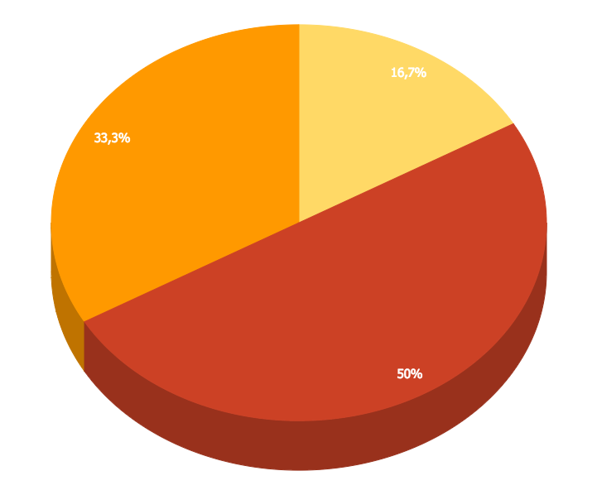
You can insert graphs from Google Sheets

Slide 54
Android Project
Place your screenshot here
Show and explain your web, app or software projects using these gadget templates.

Slide 55
iPhone Project
Place your screenshot here
Show and explain your web, app or software projects using these gadget templates.

Slide 56
Tablet
Project
Place your screenshot here
Show and explain your web, app or software projects using these gadget templates.

Slide 57
Desktop Project
Place your screenshot here
Show and explain your web, app or software projects using these gadget templates.

Slide 58
Thank you very much for your time
If you have any questions about this document please don’t hesitate to contact us at:
www.ourwebsite.com
hello@mail.me
@companyname

Slide 59
Credits
Special thanks to all the people who made and released these awesome resources for free.
Presentation template by SlidesCarnival
Photographs by Unsplash
Learn more about slidedocs at duarte.com/slidedocs

Slide 60
Presentation design
This presentation uses the following typographies and colors:
Titles: Nunito sans
Body copy: Nunito sans
Italic copy: Georgia (system font)
You can download the font on this page:
https://fontlibrary.org/en/font/nunito-sans
Orange #f67031
Yellow #ffa400
Fucsia #ed0036
You don’t need to keep this slide in your presentation. It’s only here to serve you as a design guide if you need to create new slides or download the fonts to edit the presentation in PowerPoint®

Slide 61
SlidesCarnival icons are editable shapes.
This means that you can:
Resize them without losing quality.
Change line color, width and style.
Isn’t that nice? :)
Examples:

Slide 62
😉
Now you can use any emoji as an icon!
And of course it resizes without losing quality and you can change the color.
How? Follow Google instructions https://twitter.com/googledocs/status/730087240156643328
✋👆👉👍👤👦👧👨👩👪💃🏃💑❤😂😉😋😒😭👶😸🐟🍒🍔💣📌📖🔨🎃🎈🎨🏈🏰🌏🔌🔑 and many more...

